Slide 1
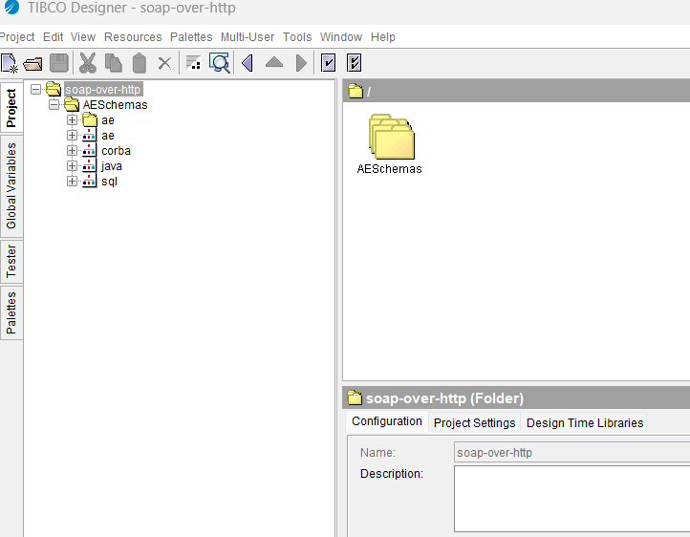
Default Files - 01

Slide 2
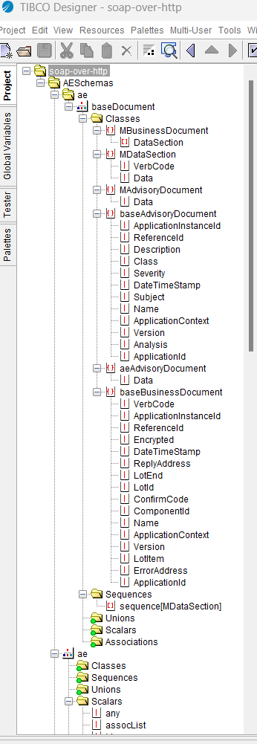
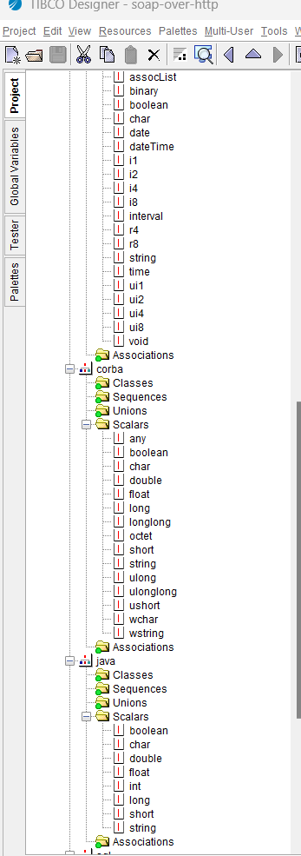
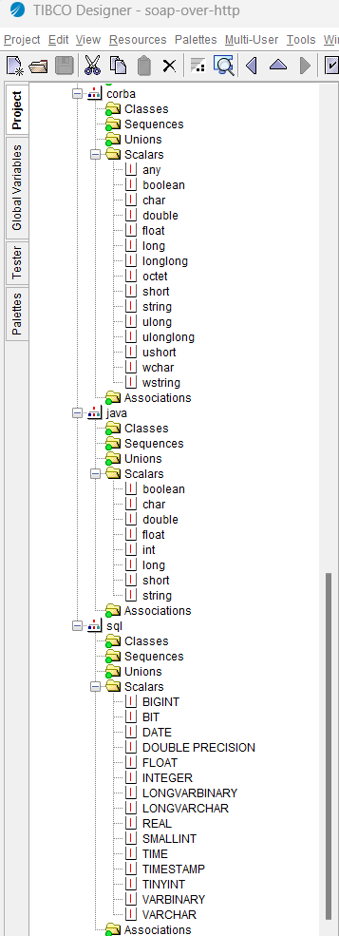
Default Files - 02

Slide 3
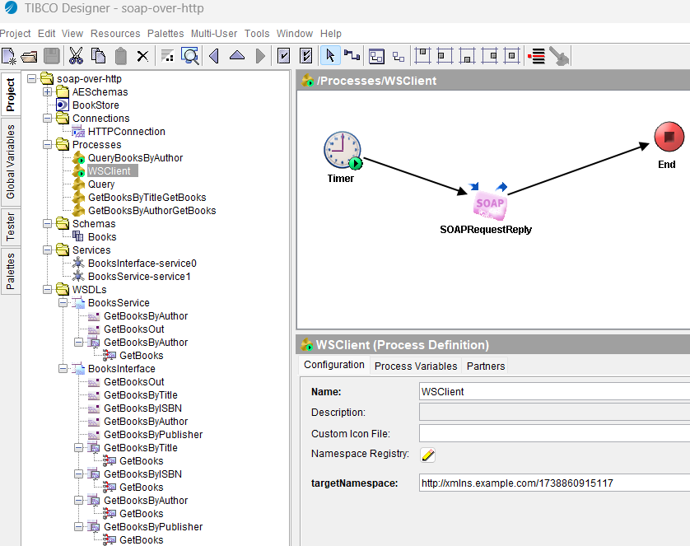
SOAP over HTTP Project On Import

Slide 4
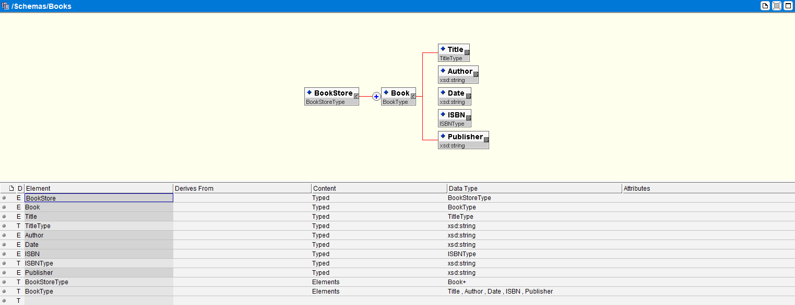
Books.xsd - Schema

Slide 5
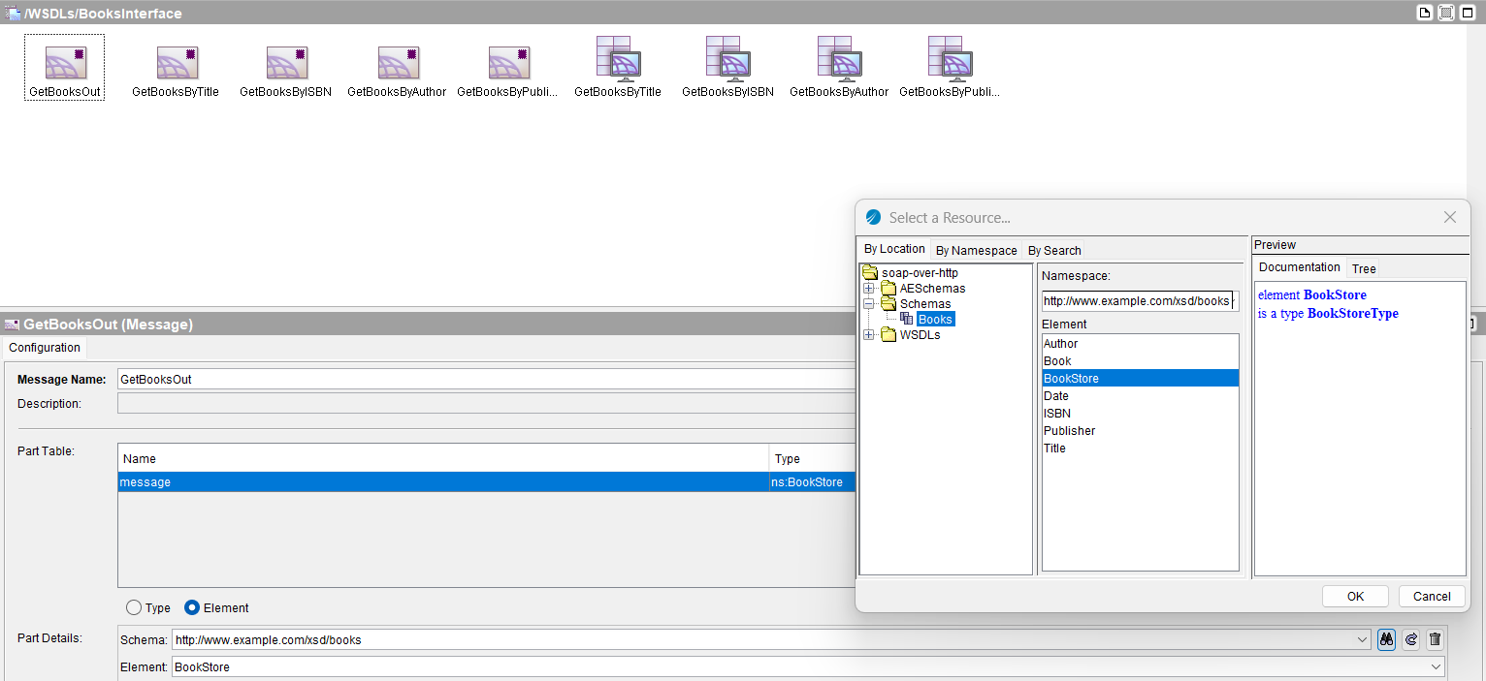
Books Interface - WSDL

Slide 6
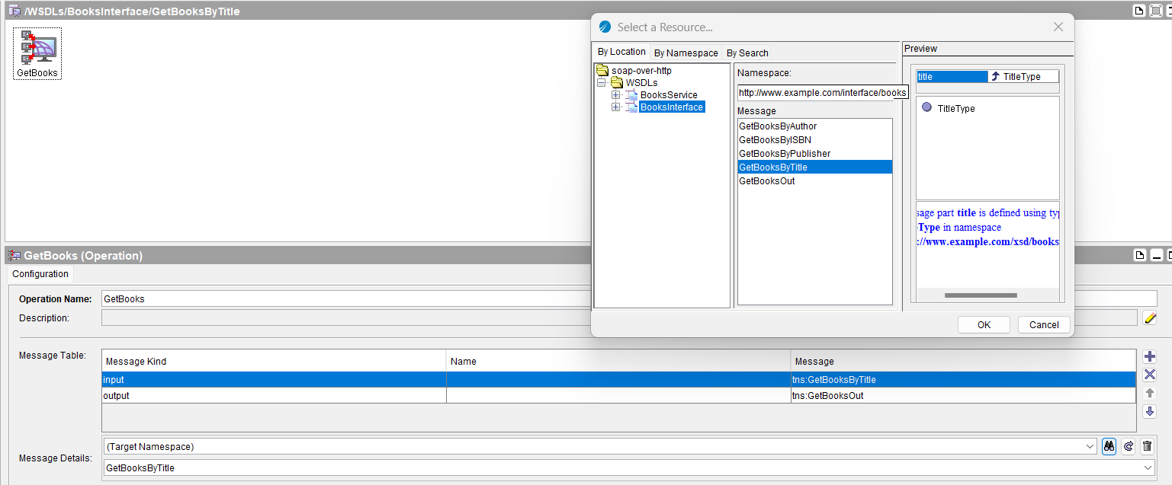
Operation - Configured Under Port

Slide 7
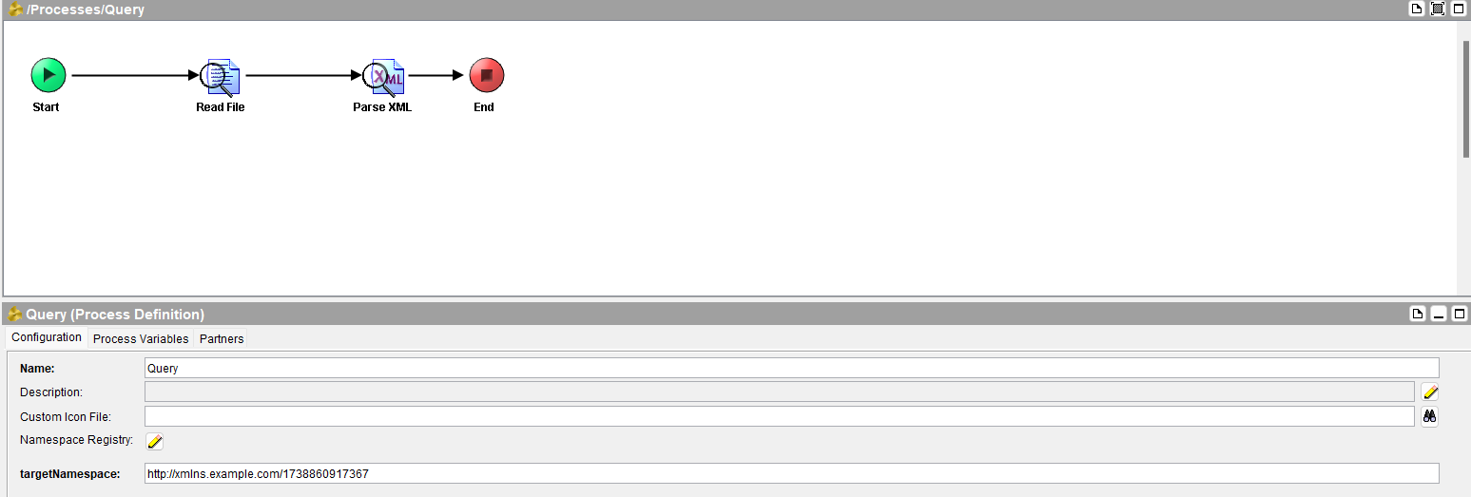
Process Definition

Slide 8
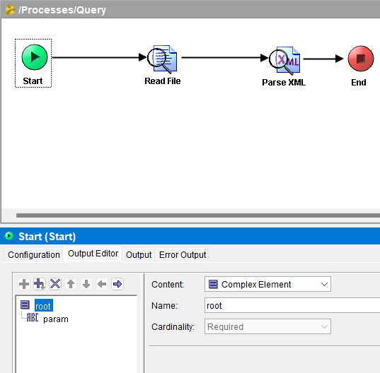
START - Schema can be inline here or referenced from your schemas

Slide 9
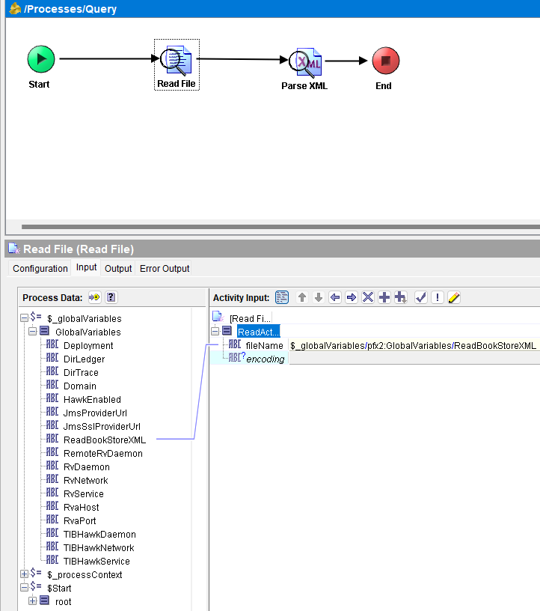
Read File - Taking input, that is path of file on system from a Global Variable in input editor

Slide 10
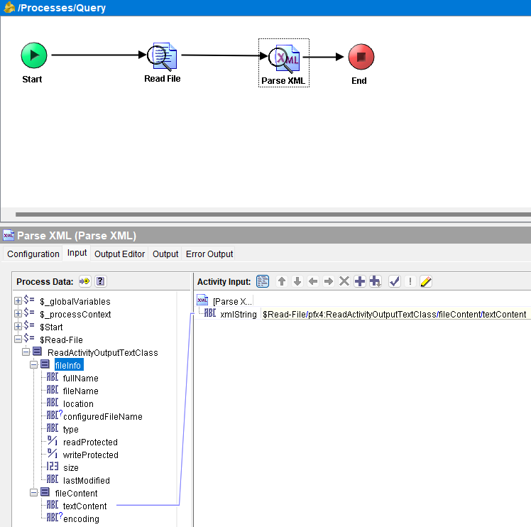
Parse XML - Taking input, from output of previous activity and reads parses content of xml file

Slide 11
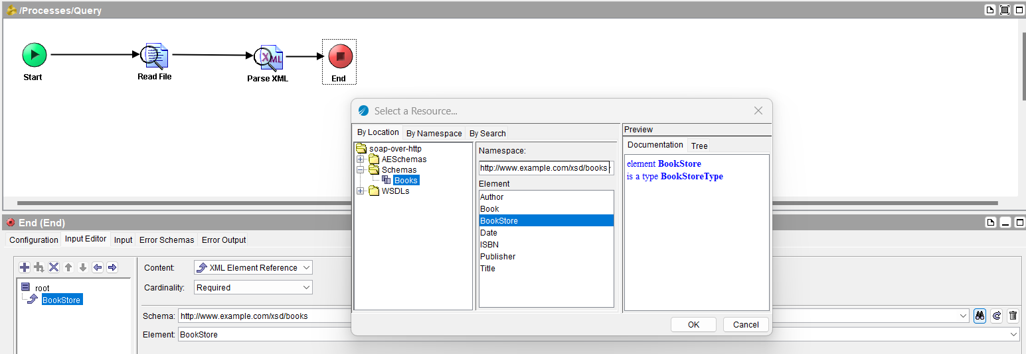
END - Here input, comes from predefined schema of our project

Slide 12
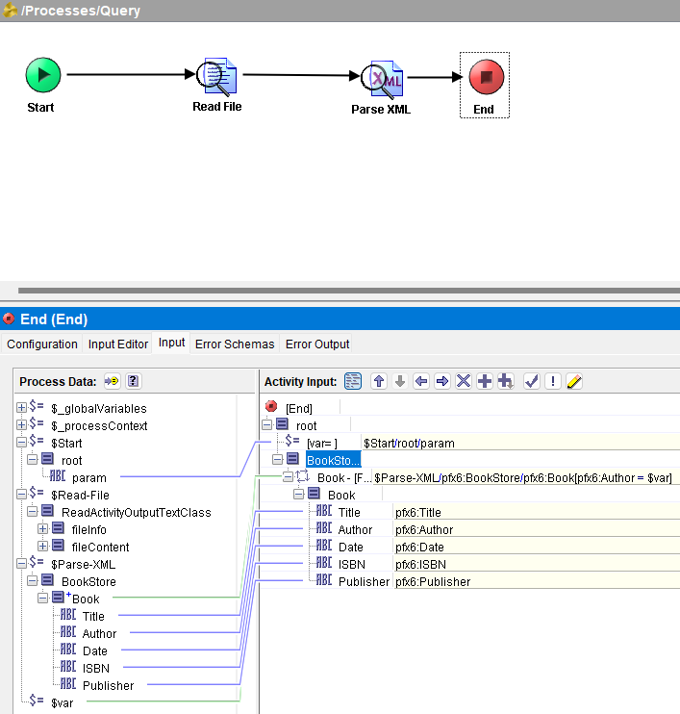
END - Mapping Output from different vars and previous outputs

Slide 13
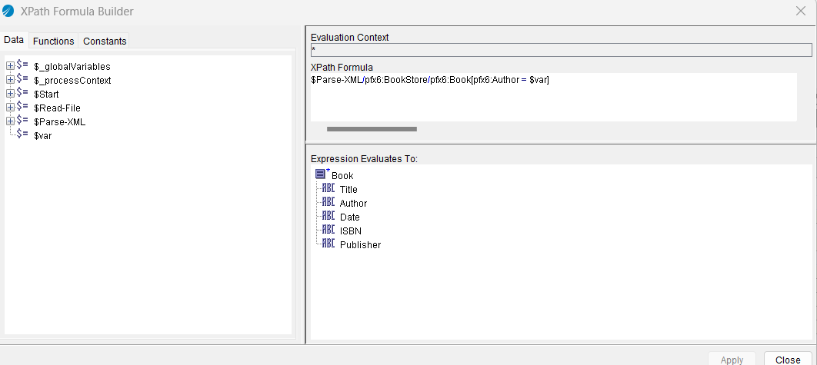
XPath Formula Builder

Slide 14
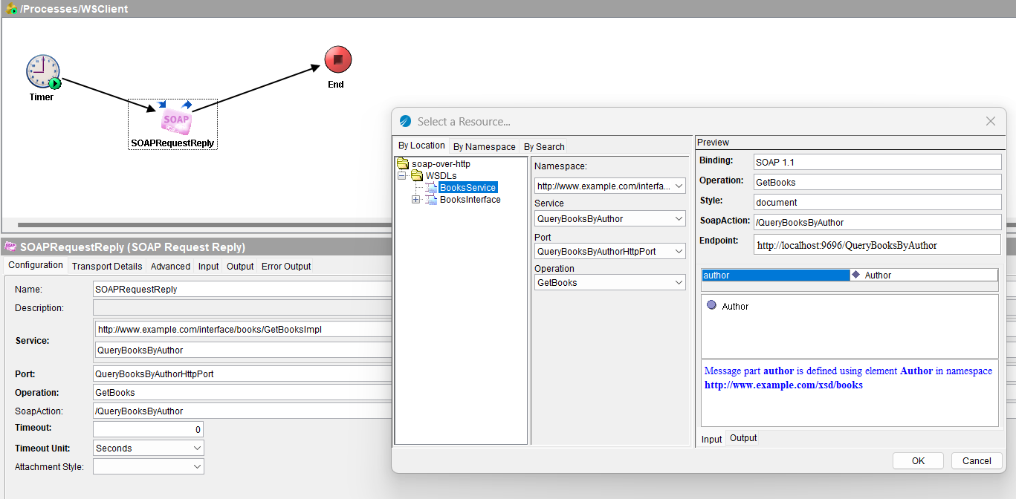
SOAP Request Reply - Configured operation to call which was defined in the WSDL

Slide 15
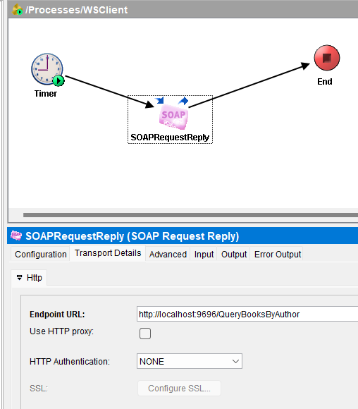
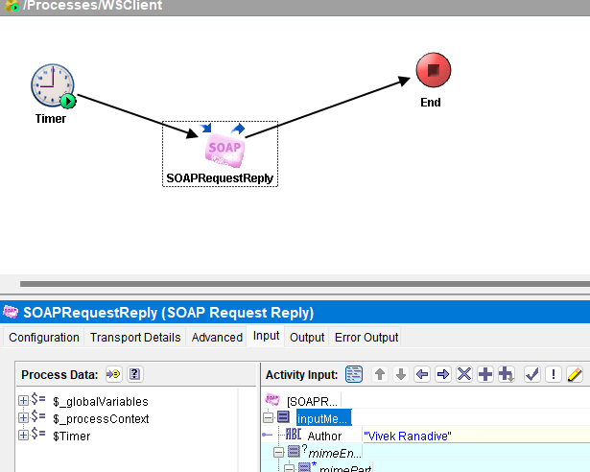
SOAP Request Reply - Define Transport and Inputs

Slide 16
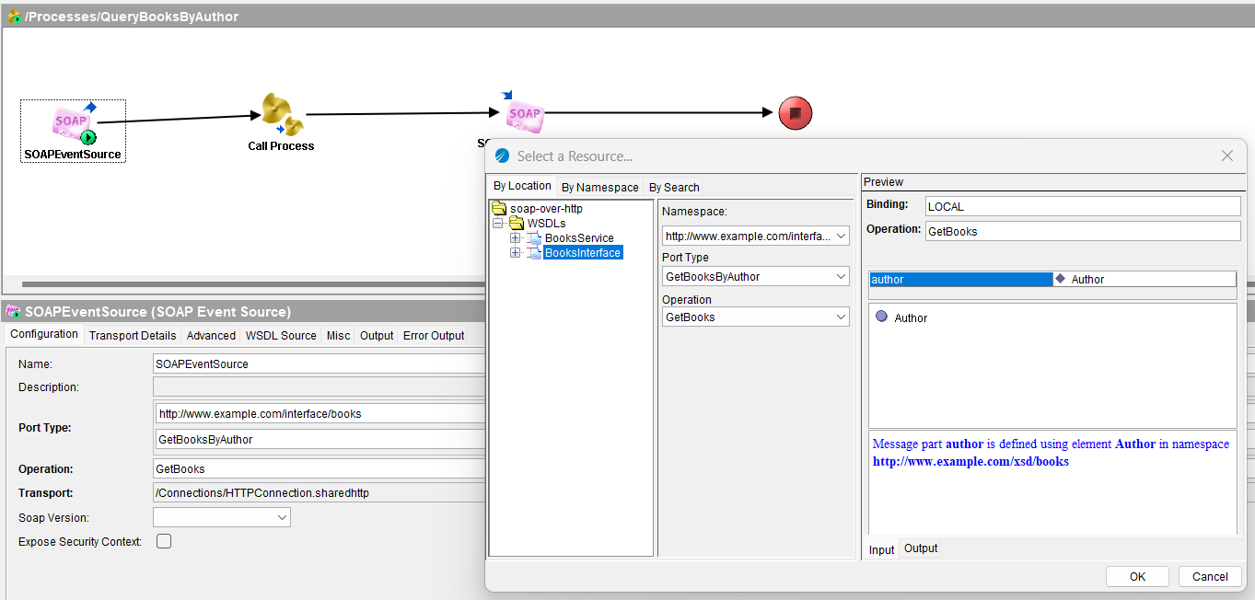
SOAP Event Source - Configure same operation so that it listens to requests on it

Slide 17
SOAP Event Source - Configure same operation so that it listens to requests on it

